Slide 1

microhttpd + HTML basic server
By - Praveen

Slide 2
How a HTTP request works

Slide 3
HTTP Methods
HEAD
PUT
POST
OPTIONS
PUT
DELETE
TRACE
CONNECT

Slide 4
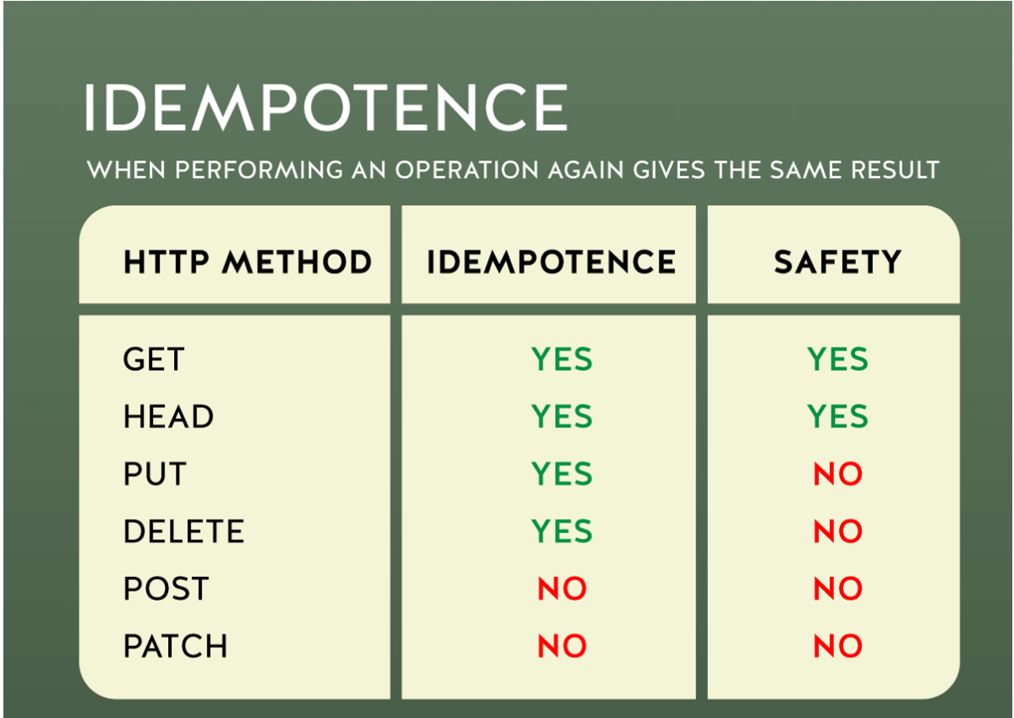
HTTP Methods: Safety and Idempotence

Slide 5
HTTP Responses
A HTTP response generally consists of three parts:
1. HTTP Status code line (version, numeric status code, human readable status code)
2. HTTP (response) headers, followed by empty line
3. HTTP response body

Slide 6
HTTP Status Codes
The numeric range of the HTTP status code is already meaningful:
Informational 1xx: Indicate a provisional response
Successful 2xx: Indicate that the client request was successful
Redirection 3xx: Indicates that further action is needed
Client Error 4xx Indicates when the client seems to have erred
Internal Server Error 5xx: Indicates cases in which the server is aware that it has erred

Slide 7
Common HTTP Status Codes
100 Continue
200 Ok
301 Moved Permanently
304 Not Modied
400 Bad Request
401 Authentication Required
402 Payment Required
403 Forbidden
404 Not Found
500 Internal Server Error

Slide 8
Exercise: HTTP/1.0 VS 1.1, GET
$ telnet localhost 8888
GET / HTTP/1.0
$ telnet localhost 8888
GET / HTTP/1.1

Slide 9
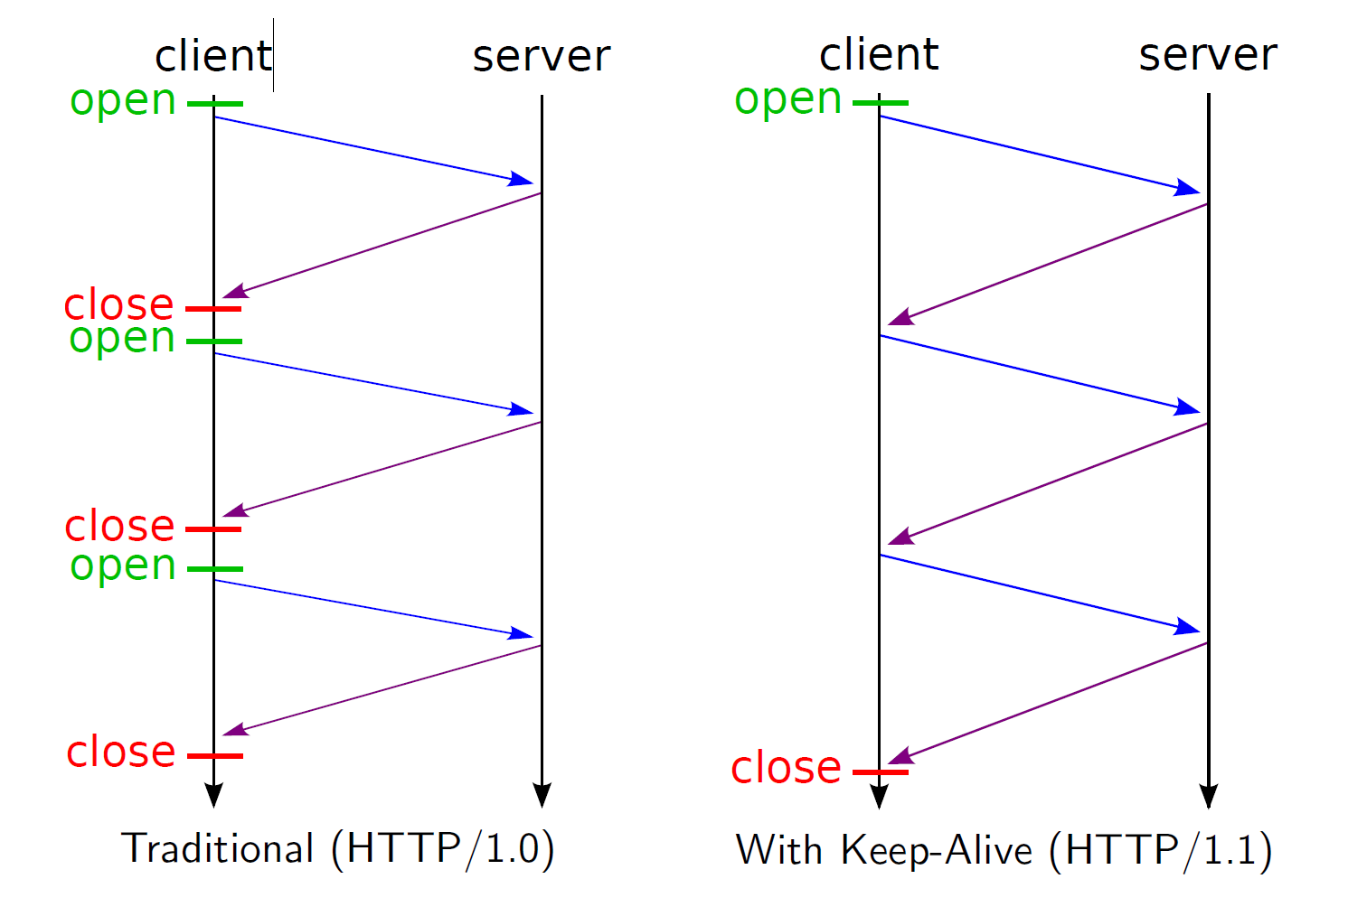
Multiple HTTP requests

Slide 10
MHD: Scales up and down!
Library binary can be as small as 32k
reportedly have users on systems with 50 Mhz processors with HTTPS
I We have users working with MHD on systems with 64 kb RAM
Users have tested streaming at about 7gbps for 20 mins , which causes high rate of HTTP requests.

Slide 11
Applications using MHD
GNUnet, P4P Portal
Gnome Music Player Client, Kiwix, XMBC, OpenVAS
Psensor, Disk Nukem, Flat8, Fawkes, Conky, CallHome
OpenDIAS, Techne, Cables communication project
Open Lightning Architecture, OpenZWave, libhttpserver
Plus many non-free applications (such as TVs, surveillance cameras, network appliances, etc.)

Slide 12
Install MHD
$ wget https://ftp.gnu.org/gnu/libmicrohttpd /\ libmicrohttpd 0.9.55.tar.gz
$ tar xvf libmicrohttpd-0.9.5 5.tar.gz
$ cd libmicrohttpd-0.9.55
$ . /configure prefix=$HOME
$ make install

Slide 13
Start MHD HTTPD
$ cd doc/examples/
$ gcc I$HOME/include L$HOME/lib\ hellobrowser.c lmicr ohttpd -o hellobrowser
$ export LD LIBRARY PATH=$HOME/ l i b
$ . /hellobrowser in another shell

Slide 14
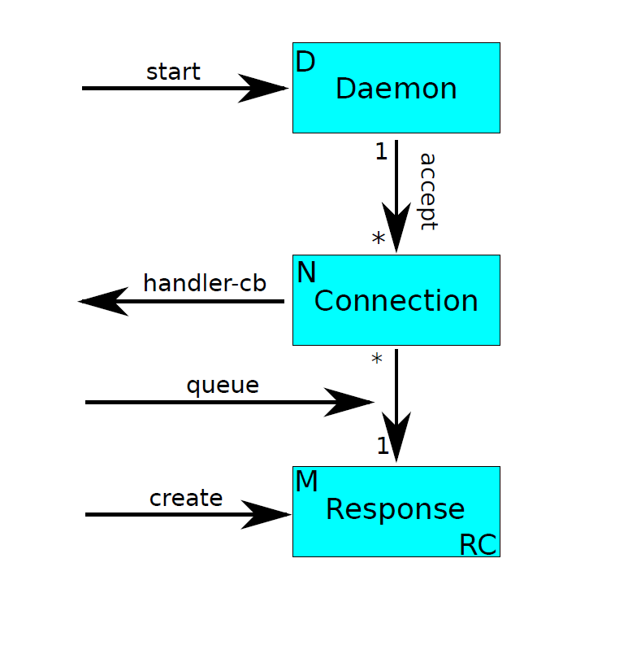
The MHD API

Slide 15
Reference manual links
https://www.gnu.org/software/libmicrohttpd/manual/libmicrohttpd.html
https://www.gnu.org/software/libmicrohttpd/tutorial.html

Slide 16
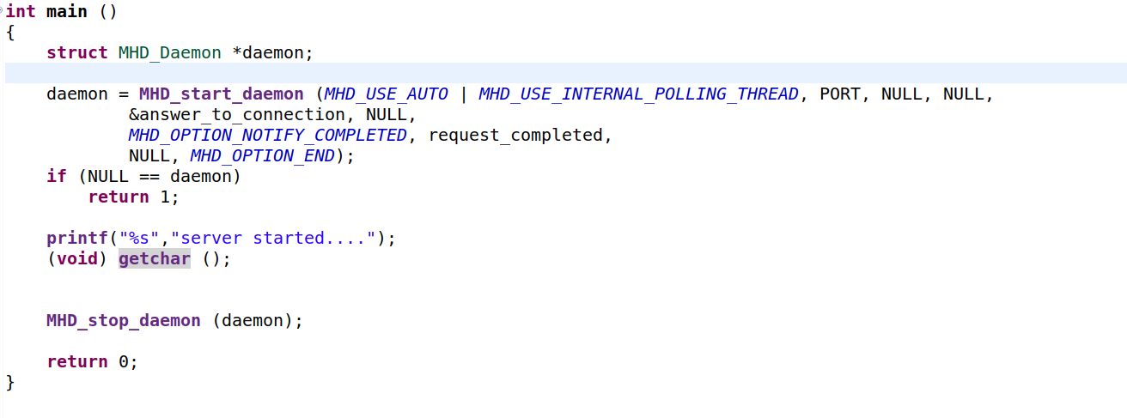
Launching MHD: The code

Slide 17
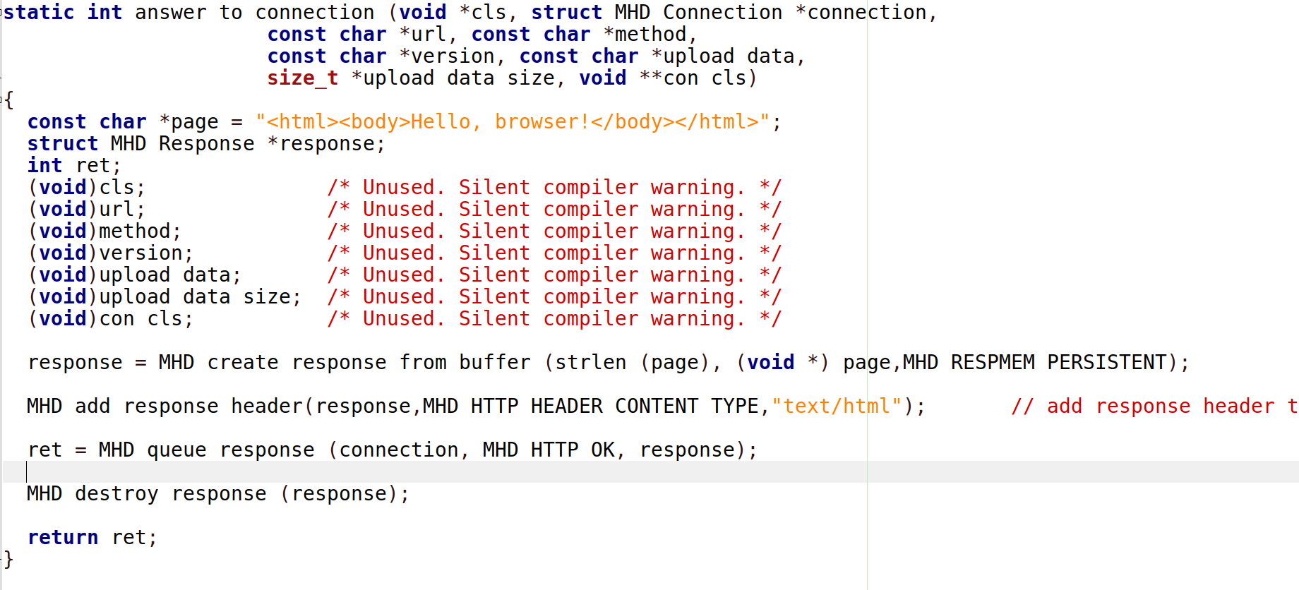
Responding to requests: The code

Slide 18
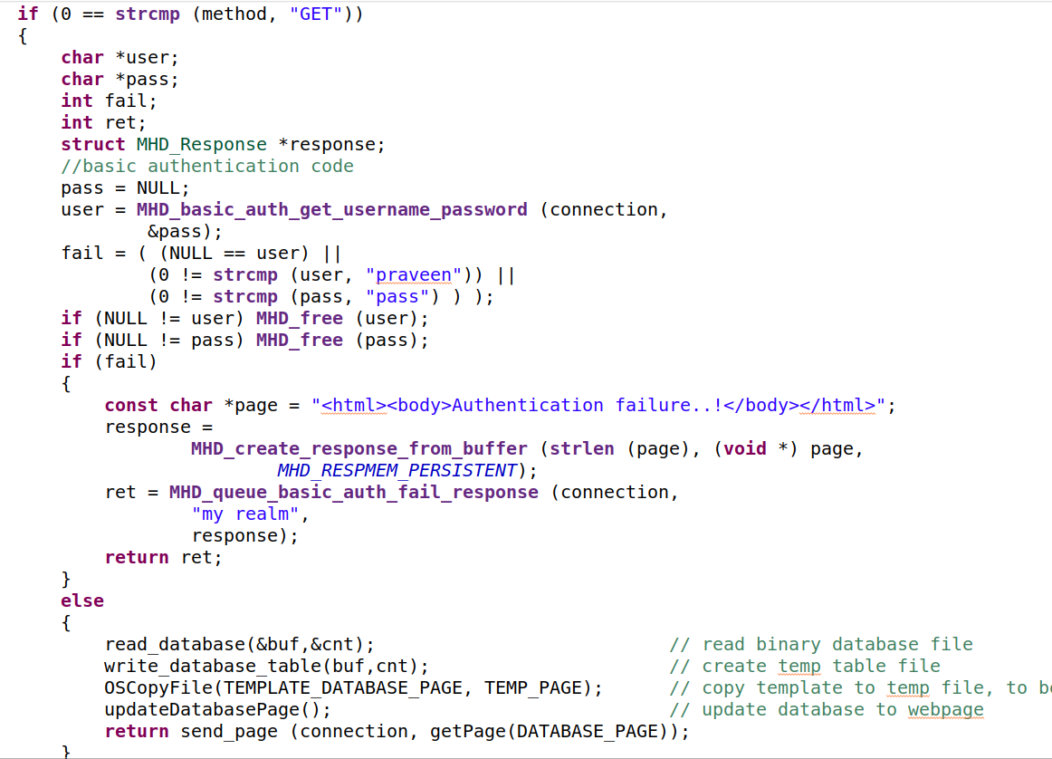
Basic Authentication

Slide 19
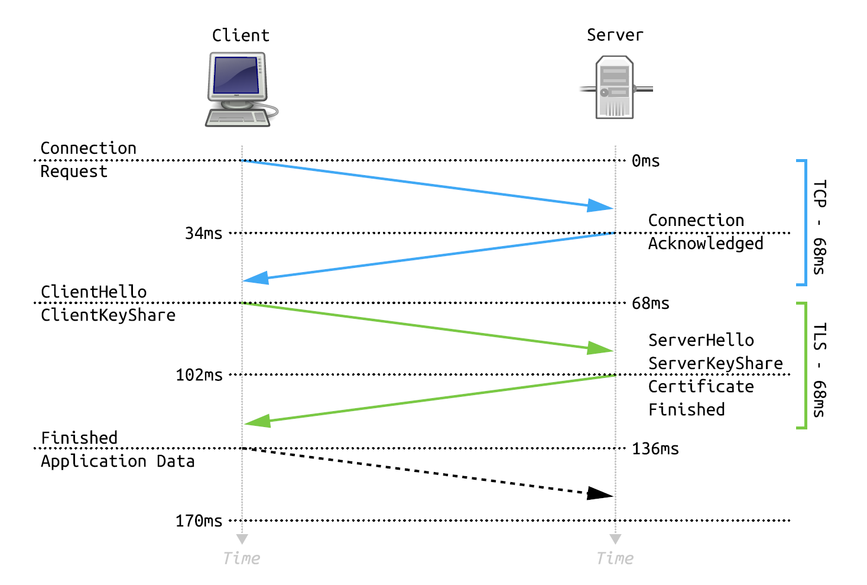
TLS Full Handshake

Slide 20
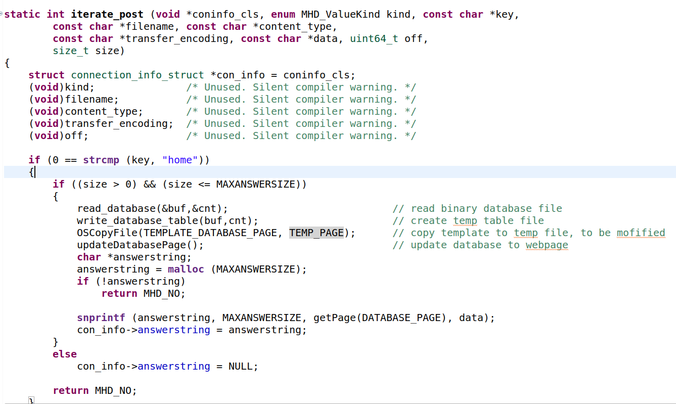
Post process iterator

Slide 21
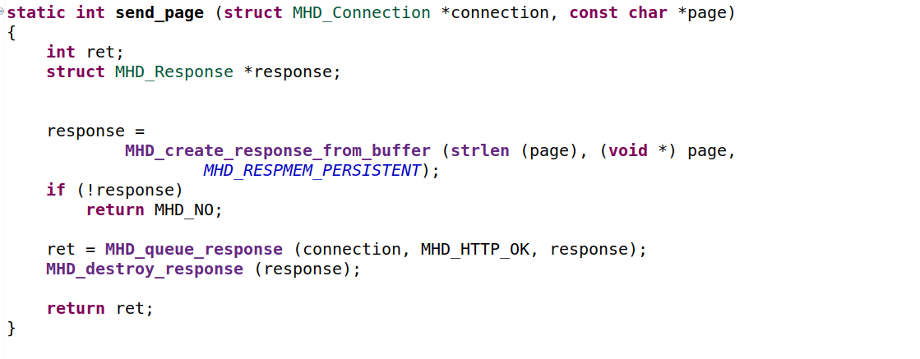
Create response method (Not in MHD library)

Slide 22
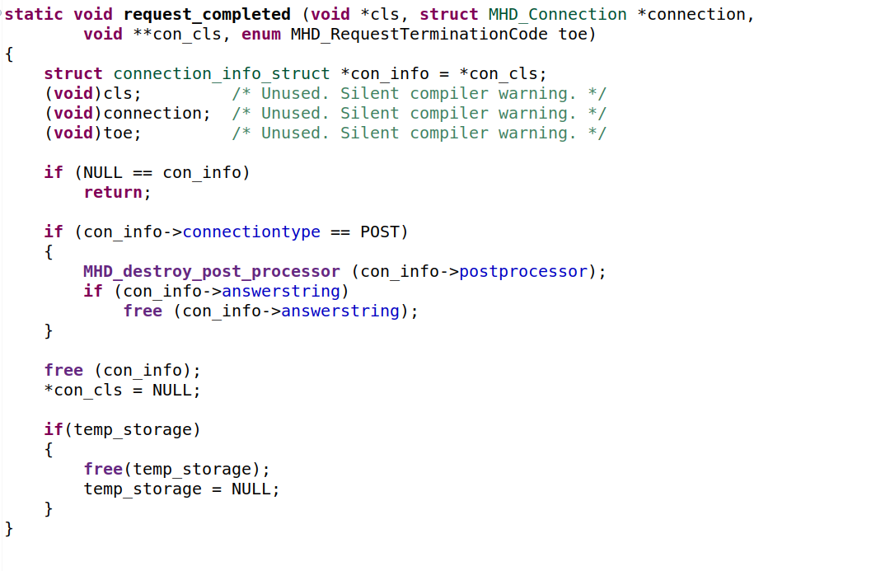
Request completed(used for cleaning data after request completed)

Slide 23
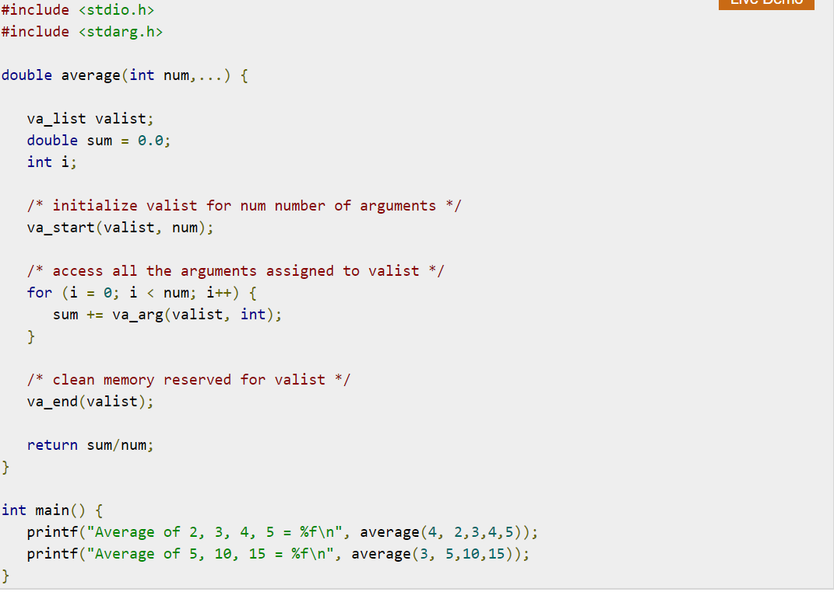
Variable argument function handling

Slide 24
Code working(database example)
Database
(add_employee,
Delete_employee,
Read_database,
Save_database)
Send To database
MICROHTTPD_SERVER
Fetch from database
response
request
Write
Read
Client
Employee.dat
(binary databse file)

Slide 25
Download Example Code
https://github.com/prawinrai1993/microhttpd_database.git

Slide 26
Thank You!
Any Questions?

